Slide 1
Excel Final Assessment [02-04-2024]

Slide 2
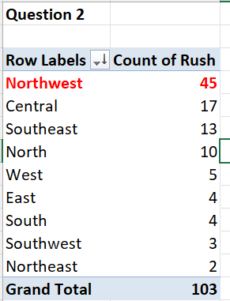
2. Which district has the highest number of rush jobs?
North West District has the highest number of rush jobs.

Slide 3
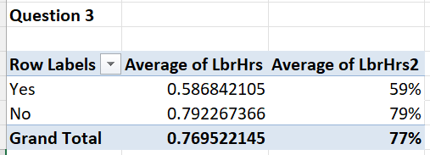
3. How does the average labour hours differ between rush and non-rush jobs?
Average Labour hours differ by 20% in which rush jobs has 59% and non-rush jobs has 79%.

Slide 4
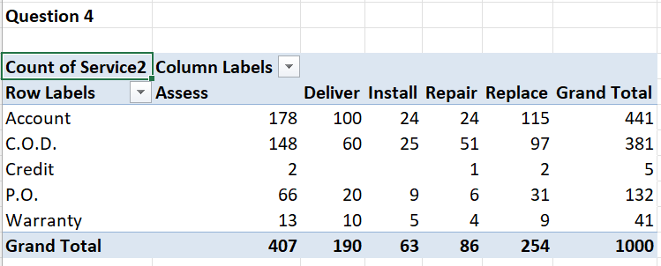
4. What is the distribution of payments types across different services?
Account Payment type has the highest record for assess service
Credit Payment type has the least record for repair service

Slide 5
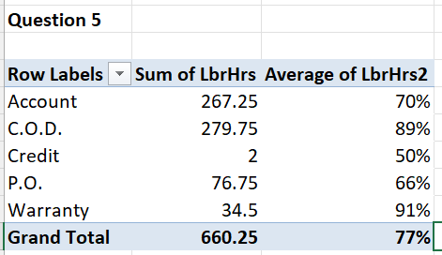
5. Are there any trends in the distribution of payments types over time?

Slide 6
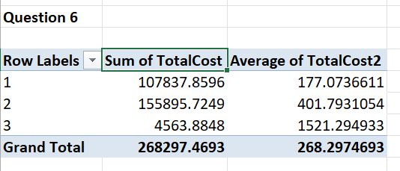
6. Is there a relation between number of technicians and total cost?
➔ There is no relation between 3 technicians required and 1&2 technicians required, but there is small relation between 1 and 2 number of technicians required.

Slide 7
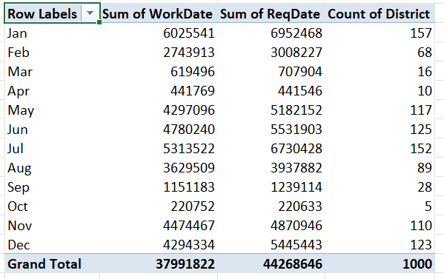
1.

Slide 8
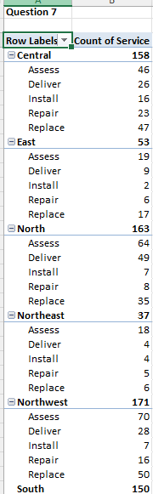
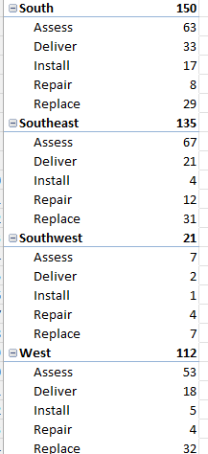
7. What is the most common type of service requested in each district?
Most Common type of service among all the districts is ASSESS.

Slide 9
8. Is there any difference in the distribution of payments types for orders with and without warranty?
➔ This is a pie chart representing the count of orders with and without warranty.
441 orders are with no account and 381 orders are of with NO COD payment coming into the NO warranty segment.
Only 41 orders are of with warranty

Slide 10
8.

Slide 11
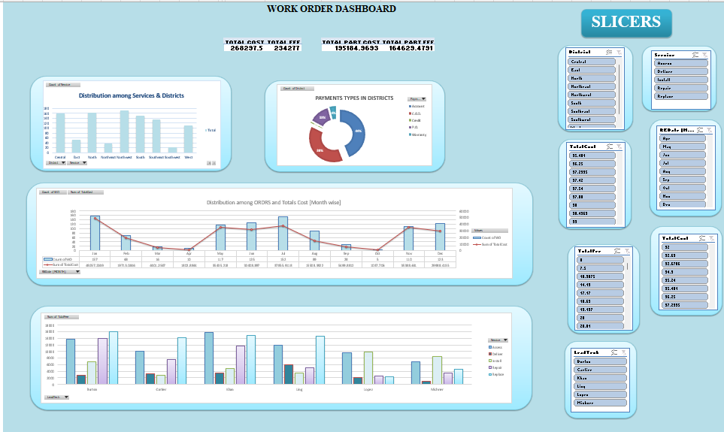
DASHBOARD

